Slide 1
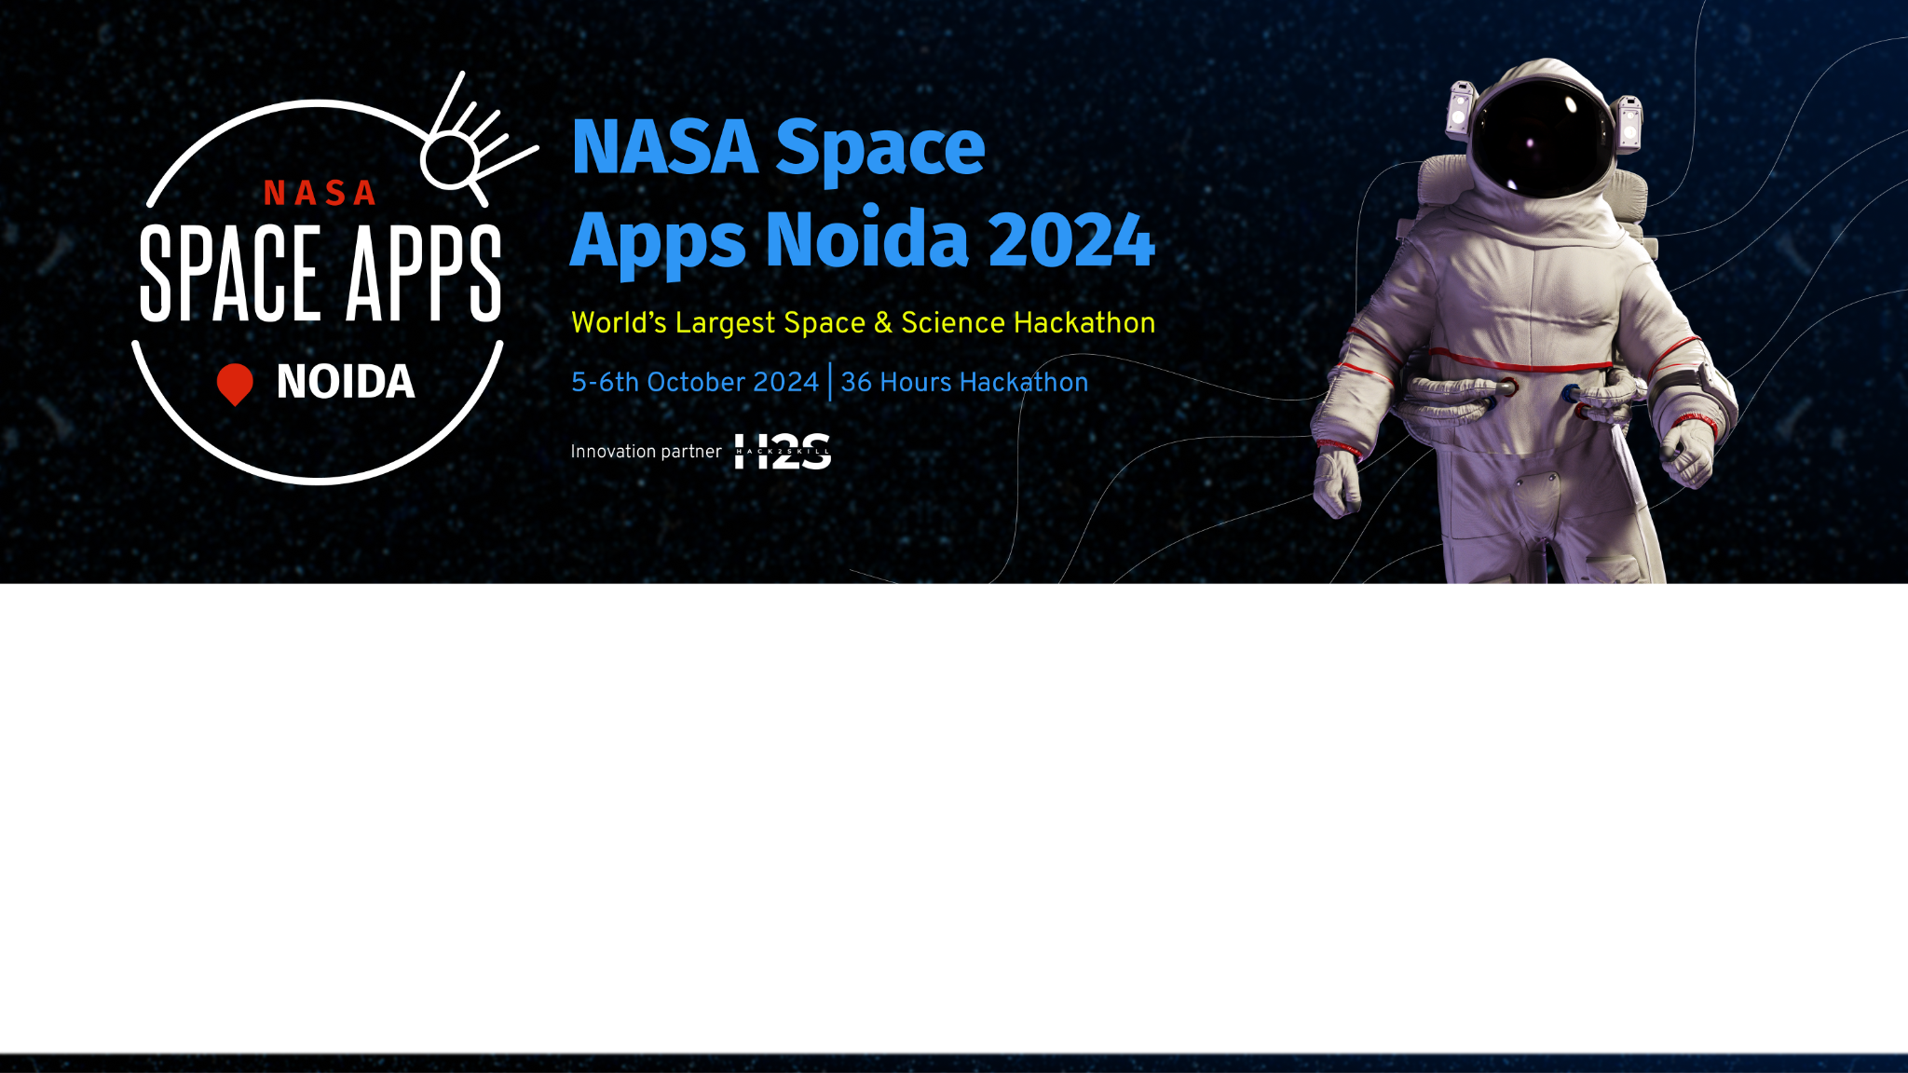
Team Details
Team name: Cypher Syndicate
Team leader name: Ankan Verma
Problem Statement: Beyond Sunlight: Designing Chemosynthesis- Based Ecosystems on Ocean Worlds

Slide 2
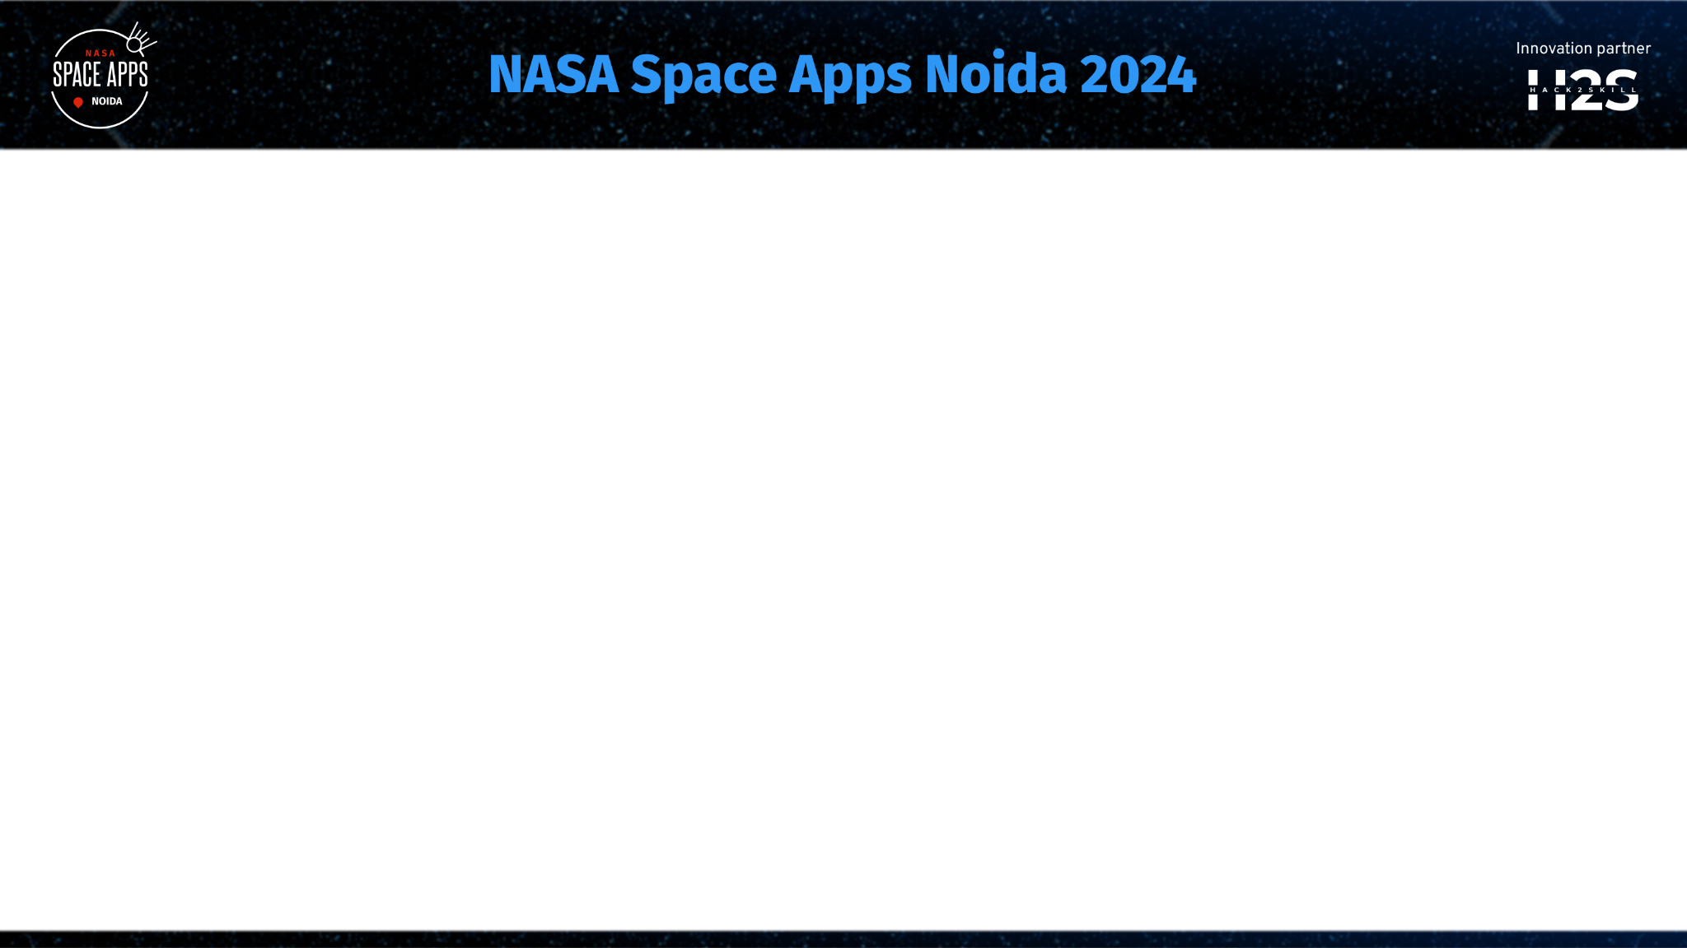

Brief about the idea
The idea is to design an interactive website that explores a hypothetical ocean world where life is sustained by chemosynthesis rather than photosynthesis. The website would provide detailed information about this unique ecosystem, showcase diverse life forms, and push the boundaries of astrobiology by simulating how such a world could exist. The platform would act as an educational and research tool, illustrating the possibilities of extraterrestrial life in environments devoid of sunlight.

Slide 3
Opportunities
How different is it from any of the other existing ideas?
How will it be able to solve the problem?
USP of the proposed solution
a. How different is it from any of the other existing ideas?
This project diverges from traditional approaches to ecosystems, which typically focus on photosynthesis and Earth-like environments. It delves into the rarely explored realm of chemosynthesis, providing users with insights into non-Earth-like ecosystems. Few projects combine astrobiology, marine biology, and educational content in such a futuristic manner.
b. How will it be able to solve the problem?
The website will educate users about alternative life-sustaining processes such as chemosynthesis, encouraging interest in astrobiology and marine ecosystems. It could also serve as a resource for scientists and students researching extreme environments, showcasing the vast potential for life outside Earth.
c. Unique Selling Proposition (USP) of the proposed solution
* A unique combination of educational content, interactive simulations, and astrobiology.
* Explores a scientifically accurate, yet futuristic concept of non-solar dependent ecosystems.

Slide 4
List of features offered by the solution
Interactive Simulations:
Users can explore different layers of the ocean world, view life forms and ecosystems that thrive on chemosynthesis.
Scientific Database:
In-depth information about chemosynthesis, extremophiles, and astrobiology.
Exploration Mode:
Allows users to navigate the ocean world, interact with various creatures, and learn about their adaptations.
Resource Section:
Links to research papers, articles, and videos on chemosynthesis and astrobiology.
Quizzes and Activities:
Educative challenges and quizzes for students and enthusiasts.
Collaboration Portal:
Forum for researchers and educators to discuss the topic and share resources.

Slide 5
Process flow diagram or Use-case diagram
User Registration/Login:
New and returning users can register and log in to track progress.
Homepage:
Introduction to the ocean world and its chemosynthetic ecosystem.
Exploration Mode: Users can dive into the ocean, explore different species, and learn about their habitats.
Information Hub: Repository of articles and research papers on astrobiology, chemosynthesis, and similar topics.
Interactive Simulations: Users can simulate conditions of this ocean world and see how ecosystems react.
Quiz/Assessment: Engaging quizzes to test knowledge after exploring the world.

Slide 6
Wireframes/Mock diagrams of the proposed solution (optional)

Slide 7
Architecture diagram of the proposed solution
Component | Description
Front-End | Built with HTML5, CSS3, JavaScript frameworks (React or Angular), providing an interactive user interface.
Back-End | Node.js or Django for handling user sessions, data requests, and interactions, ensuring smooth functionality.
Database | MongoDB or PostgreSQL to store user data, research resources, species data, and quiz results, managing data efficiently.
3D Simulation Engine | Use of WebGL, Unity WebGL, or Babylon.js for interactive 3D simulations, creating an immersive experience.
APIs | Integration with scientific databases (like NASA Exoplanet Database) for real-time data and educational content, providing accurate and up-to-date information.

Slide 8




Technologies to be used in the solution
HTML5
For structuring the website's content and layout, ensuring a robust foundation.
CSS3
For styling and visual presentation, creating an aesthetically pleasing and user-friendly experience.
JavaScript (React/Angular)
For interactive elements, dynamic content, and user interface responsiveness, enhancing user engagement.
MongoDB
For storing and managing data efficiently, ensuring data integrity and accessibility.

Slide 9
Estimated implementation cost (optional)

Slide 10
Snapshots of the prototype

Slide 11
Prototype Performance report/Benchmarking

Slide 12
Additional Details/Future Development (if any)

Slide 13
Provide links to your:
GitHub Public Repository
Demo Video Link (3 Minutes)
Final Product Link

Slide 14
Proof of Registration on https://www.spaceappschallenge.org/nasa-space-apps-2024/2024-local-events/noida
Add screenshots of your registered profile on the above mentioned link.
Screenshots to be added for all of the team members.

Slide 16
